Slide 1



P.E.S COLLEGE OF ENGINEERING, MANDYA.
PESCEglobe
Presented by
Guided by
Anchal (4PS19EC014)
Adeeba (4PS19EC003)
Ashrita (4PS19EC020)
Hrittik (4PS19EC062)
Mrs. MEGHANA S
Assistant Professor, Dept. of ECE
Submitted for the partial fulfillment
of
BACHELOR OF ENGINEERING DEGREE
Department of Electronics and Communication
2022-2023

Slide 2

Content
Introduction
Problem statement
Literature survey
Proposed system
Objectives
Methodology
Blocks of the systems
Tools and technologies
Cost of the system
Conclusion
References
PESCEglobe
2022-2023
2

Slide 3
1. Introduction
PESCEglobe facilitates us to explore all the activities taking place in the college, different reports and queries are generated based on vast options related to students, batch, course, faculty, exams, semesters, certification and all the amenities required for the college.
College portal provides a simple interface for maintenance of student-faculty information.
Student information system deals with all the details of a student from the day one to the end of the course.
It is supported to reduce the hardships faced by the faculty in managing sessions, lectures, student’s attendance and all the aspects related to them.
The aim is to automate its existing manual system by the help of computerized equipment’s and full-fledged computer software, fulfilling their requirements so that their valuable data or information can be stored for a longer period with easy accessing and manipulation of the same.
PESCEglobe
2022-2023
3

Slide 4
2. Problem statement
The registration problem due to some manual means of operations which easily lead to misplacement or loss of student information. A lot of difficulties had to be faced by the faculty in maintaining records of all the students. To make an institute technologically advanced, educators usually end up having multiple software systems to manage administrative operations and ensure student retention; which is not feasible in the long run. With the increasing EduTech advancements, it is a must to choose an excellent software like a Student Management System that can help in automating and streamlining all the operations related to students.
PESCEglobe
2022-2023
4

Slide 5
3. Literature survey
Sr. No. | Author | Title | Source | Findings/Remark
 | Name (year) | Title of research articles / book | Journal /Publication/ Research | Your findings and remarks about this work
1 | Robert Moskowitz (2017) | The Magazine for Leaders in Education | Journal | Portal provides a centralized source of information and services for students, faculty, suppliers, administrators
2 | FEU-EAC(2020) | Online Student registration Portal | Research | Portal give privilege to the students to submit their requests and transactions via Internet Enrolled students
3 | Tejaswini Chavan , Deb Dutta | Online College Portal | Research | Enhancements and features such as calendars, to do lists, schedules, hours of operation, discussion groups and chat, announcements and alerts, job openings, career opportunities, reports and documents
PESCEglobe
2022-2023
5

Slide 6
Sr. No. | Author | Title | Source | Findings/Remark
 | Name (year) | Title of research articles / book | Journal /Publication/ Research | Your findings and remarks about this work
4 | Olsen, F. (2002) | University portal | Research | To create a point of access for administrative functions for students, such as registration, financial aid and academic records, or for staff, such as timesheets, leave balances .
5 | Strauss. (2000) | Design and implementation of an online portal registration | Case Study | Students can access the e-registration site from anywhere with an internet connection
PESCEglobe
2022-2023
6

Slide 7
4. PROPOSED SYSTEM
Students will have an access to all the soft copies of important documents and SEE marks sheets through the portal.
Students and Faculties can rise any concern to the college authority or office directly through the portal.
Students are able to give the feedback semester wise about the faculties via portal.
Students can apply for the certificates( eg. bonafide, study, migration, character certificate) via portal.
Faculty can directly take the attendance through the portal via phone in the class instead of having the burden of physical file system and updating them.
All the college election voting system can be done through the portal.
PESCEglobe
2022-2023
7

Slide 8
5. Objectives
To implement the Server by Apache server and build the basic database of the server and divide into different sections for different data’s using MYSQL.
Developing a New Portal Site name to host the portal using github host.
Updating the Look and Feel of the Portal using coding implementation (HTML, CSS, JS)
Implementing front-end using HTML and CSS, with Java Script for client-side validation and back-end using PHP and SQL.
Building views for four end users which include the Administration, Faculty, Students and the outsiders.
PESCEglobe
2022-2023
8

Slide 9
6. Methodology
First of all, we analysed the current system users. Registration activities involve all undergraduate students, graduate students, most of teachers, graduate schools, academic affairs office, and all related education administrators. Considering the large number of system users and wide coverage, the users are separated into three categories:
• Student: It refers to the undergraduate and graduate students who will inquire online courses and complete registration steps to generate personal registration table.
• Teacher: It refers to the users who will deliver courses, and check the status of online course registration.
• Administrator: It refers to the users who will control registration process, adjust detailed information of online courses according to the real-time registration status, and complete administration tasks in the background including drawing lots, willingness release, etc.
PESCEglobe
2022-2023
9

Slide 10
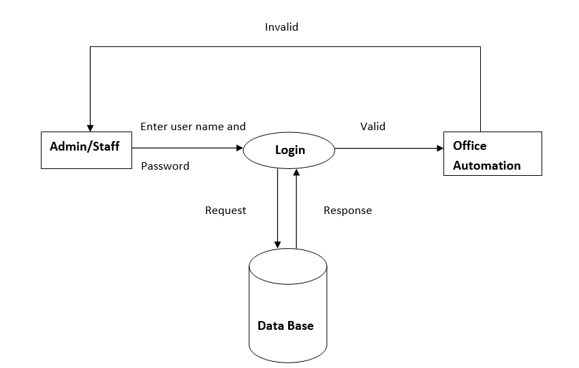
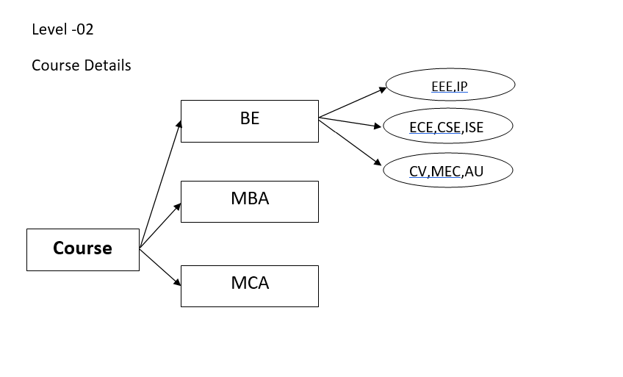
7. Blocks of the systems
Fig.1: STORAGE TO LOGIN FRAME Fig.2: COURSE BRANCHING
PESCEglobe
2022-2023
10

Slide 11
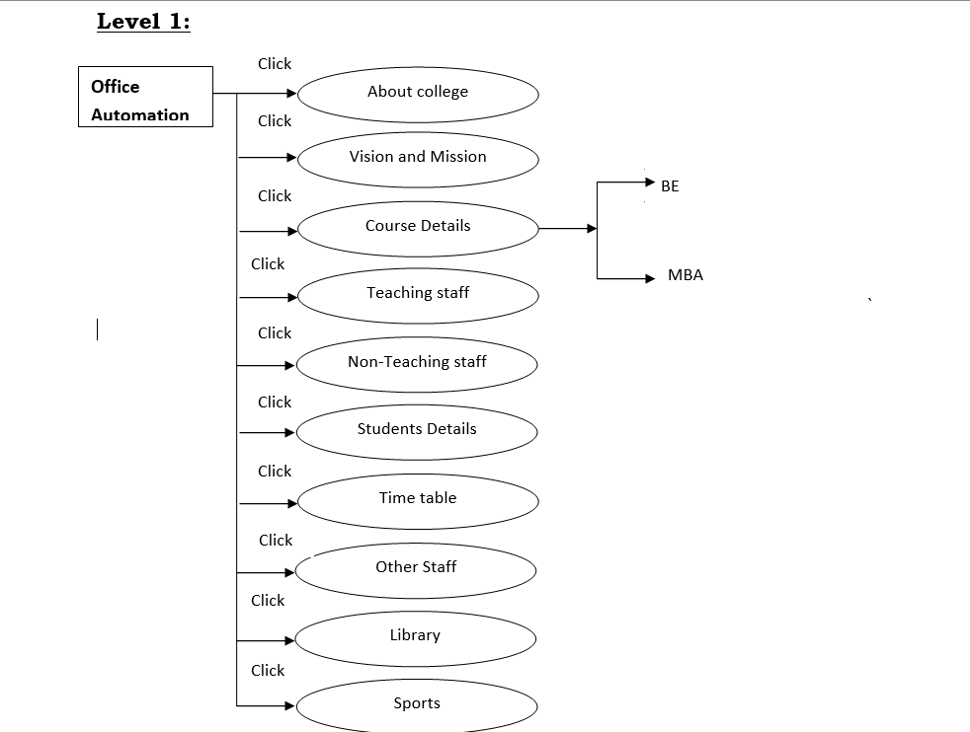
MCA
Fig.3: NAVIGATION FLOWCHART
PESCEglobe
2022-2023
11

Slide 12
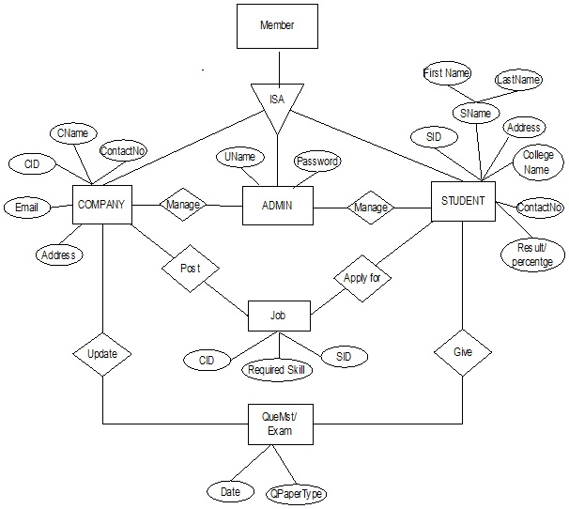
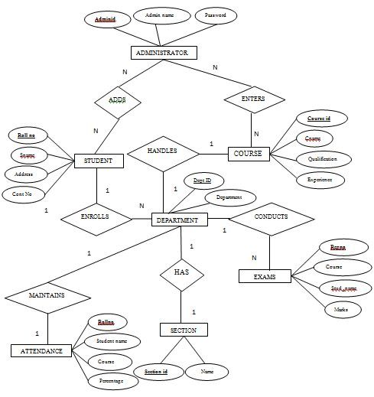
Fig.4: ER Diagrams
PESCEglobe
2022-2023
12

Slide 13
8. Tools and Technologies
Software Requirement:
Server used for offline access:
WAMP Server
XAMPP Server (php version 5.5)
MAMP Server
LAMP Server
For database making and editing
My SQL
Postgresql
For coding environment
Visual Studio(with required extension)
For testing environment
Github
Technology Used:
.NET FRAMEWORK
HTML
CSS
SQL
JAVASCRIPT
PHP
PESCEglobe
2022-2023
13

Slide 14
9. COST OF THE SYSTEM
Phase 1 : In initial phase of the project the cost analysis for the project is null as the programming interfaces are free and we are only running the UI(user interface) on the offline server.
Just for checking the practical abilty of the project.
Phase 2 : If further the project is funded we will go for a cloud based back end architecture and implement in the real world application with .apk (android application package), .exe ( executable computer file) that would totally cost us around a budget in the range 50,000.
Phase 3 : For the final implementation of the project, college has to hire a software administrator as per the salary negotiation to update and fix the time-to-time requirements.
PESCEglobe
2022-2023
14

Slide 15
10. Conclusion
The project assists in automating the existing manual system. It is a paperless work. It can be monitored and controlled remotely.
It reduces the man power required and provides accurate information. All years together gathered information can be saved and can be accessed at any time. The data stored in the repository helps in taking decision by management. So it is better to have a Web Based system.
The maintenance is done only by authorized person which called as admin user. Thus the application is more flexible and changes can be made without any difficulty.
The purpose of online or web based activities in particular online admissions is to provide convenience, save time, bring more objectivity, transparency and speedy transactions over the manual operations.
PESCEglobe
2022-2023
15

Slide 16
11. References
Rajkumar Shah, Ahmed Tanwar, Malav Shah, Shreyash Pandey, “Online College Portal”, International Research Journal of Engineering and Technology (IRJET), Volume: 04 Issue: 01 Jan -2017.
Tejaswini Chavan, Deb Dutta, Michelle Gomez and Alvino Vaz, “Online College Portal”, Information Technology Department, Xavier Institute of Engineering, Mahim (W), Mumbai, India Accepted 31 March 2015, Vol.5, No.2 April 2015
Looney, M. and Lyman, P., (2000). Portals in higher education. Educause Review 35.4.
Matovu, M, “Availability, accessibility and use of ICT in management of student’s academic affairs” Makerere University, 2009.
Katz, R. N. “A home page doth not make a portal” about web portals, jossey-bass A Wiley Company, 2002.
PESCEglobe
2022-2023
16

Slide 17
THANK YOU
PESCEglobe
2022-2023
17

